Slide 1
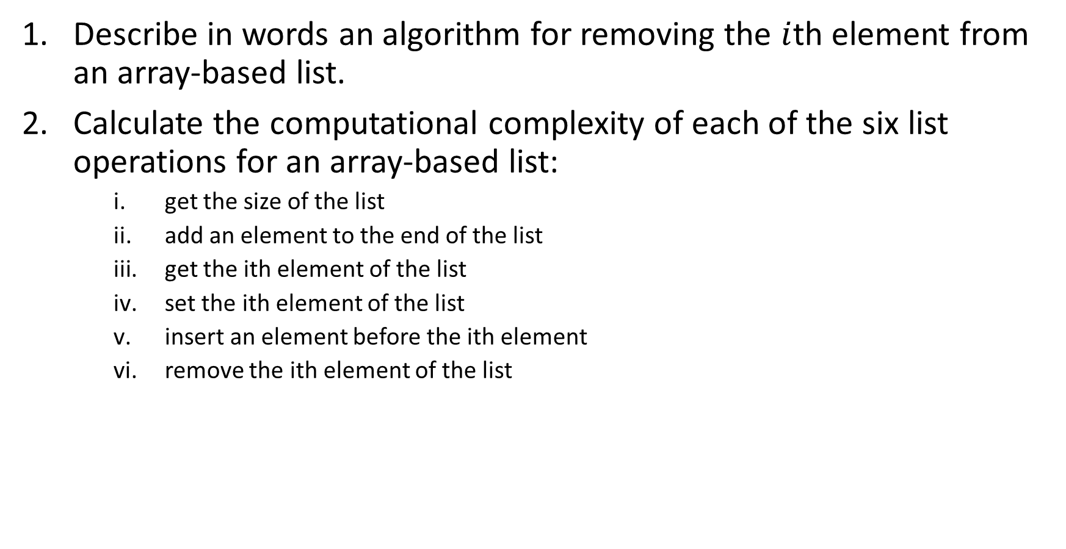
Describe in words an algorithm for removing the $i$th element from an array-based list.
Calculate the computational complexity of each of the six list operations for an array-based list:
    get the size of the list
    add an element to the end of the list
    get the ith element of the list
    set the ith element of the list
    insert an element before the ith element
    remove the ith element of the list

