Slide 1
2. What is a computer program?
Lecture slides for What Can Be Computed?

Slide 2
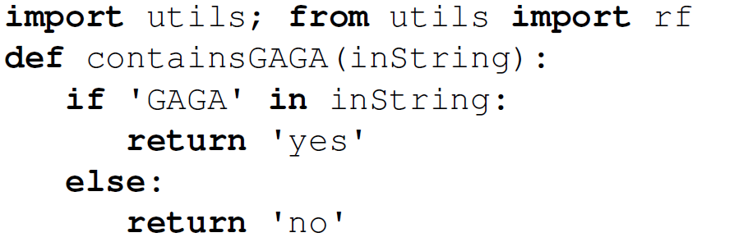
In this course, we use only SISO python programs
“SISO” means “string in, string out.” So all programs receive a string as input and return a string as output.
  We sometime also allow multiple string inputs
The input parameter is always a string, usually named “inString”
The returned value is always a string.

Slide 3
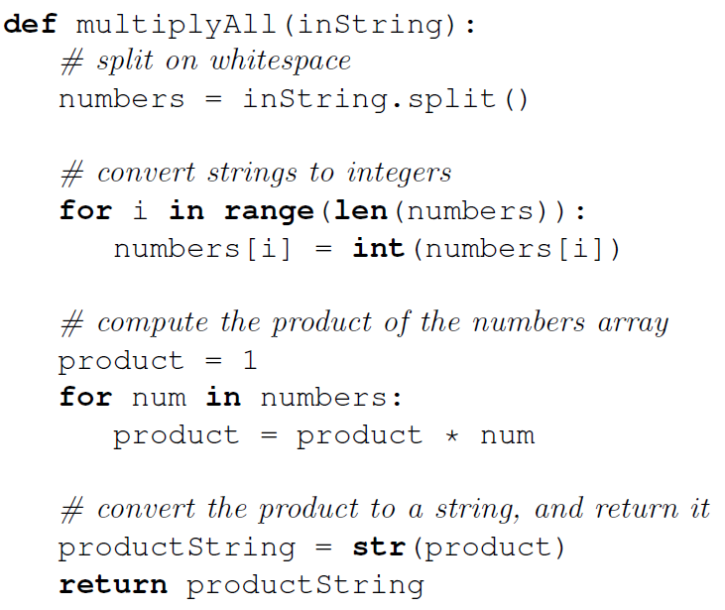
In our SISO programs, numeric inputs and outputs must be converted to/from strings
Here, inString is a single string containing some numbers separated by space characters, e.g. “54 21 7 43”
The array numbers contains a list of strings at this point, e.g. [“54”, “21”, “7”, “43”]
Now the array numbers contains a list of integers, e.g. [54, 21, 7, 43]
The final answer is conceptually an integer, but because of our SISO requirement, it is converted into a string before being returned.

Slide 4
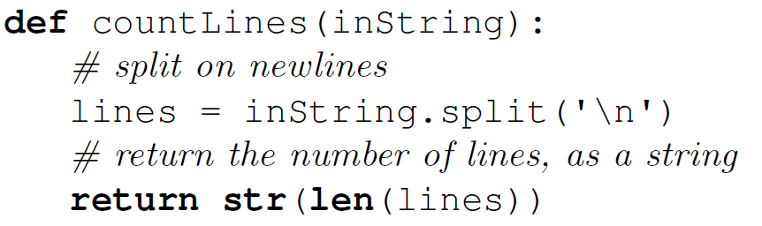
In this course, we use ASCII strings
ASCII is a standard character set of 128 characters including all of the following:
  !"#$%&'()*+,./0123456789:;<=>?@ABCDEFGHIJKLMNOPQRSTUVWXYZ[\]^_`abcdefghijklmnopqrstuvwxyz{|}~
ASCII also includes newline and space characters
Therefore, a SISO program can receive and return large multiline blocks of text
The syntax ’\n’ represents a single ASCII newline character

Slide 5
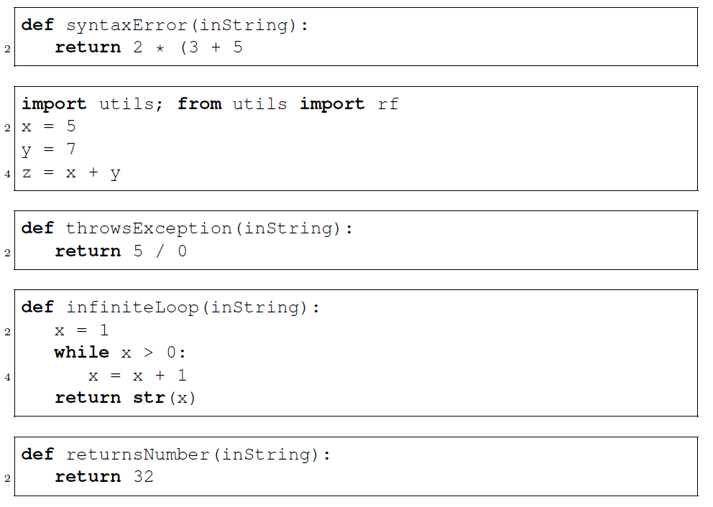
Programs can fail to be legitimate SISO programs for many reasons

Slide 6
P(I) is the output of program P on input I
The formal definition is technical. Read about it for background knowledge but make sure to understand the high-level idea…
The first function in P is the main function
P(I) is the output of P when the main function receives I as input
BUT P(I) is undefined if:
  P doesn’t terminate
  P returns a value that isn’t an ASCII string
  P throws an exception

Slide 7
A decision program always returns “yes” or “no”
If P(I) = “yes”, P accepts I
If P(I) = “no”, P rejects I
For example, containsGAGA.py:
  Accepts “GAGA”, “CGCAGACTGAGATTTA”
  Rejects “”, “AGA”, “TTTTTTTTT”
Programs are equivalent if they produce the same outputs on the same inputs

Slide 8
Why is it okay to study only SISO Python programs?
Real-world programs receive many kinds of input and output
But our theoretical results for SISO programs can be easily generalized to all other types of computer programs
  All input and output to computers ultimately consists of binary strings, i.e. 1s and 0s
  Binary strings can easily be converted to and from ASCII
The restriction to Python is convenient, but unnecessary
  We will see later that Python programs are equivalent to other standard models of computation, including Turing machines and all other reasonable programming languages and real computers.

